Slide 1
G Series Drive Shaft
Service and Troubleshooting Guide
Part 1: G Series Tail Shaft Repair
Part 2: G Series Sliding Gear Shaft Repair
Phone (352) 629-5020
www.HaleTechnicalService.com
Notes:
Hello and welcome. This is part one of a two part repair series on the G Series gearbox. Part one covers the disassembly and reassembly of a G Series Tail Shaft assembly. Part two covers the disassembly and reassembly of a G Series Sliding Gear Shaft assembly.

Slide 2
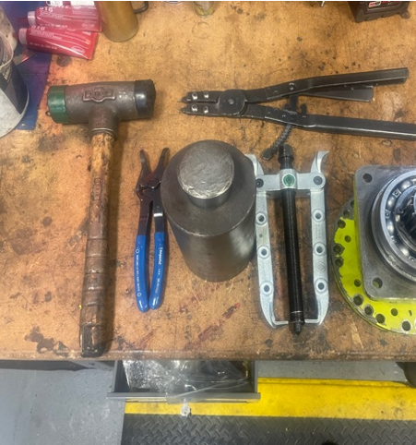
Part 1 – 537-1530-50-0 Tail Shaft Assembly Repair
G Series Tail Shaft Assembly Repair
This guide is meant to help assist with the rebuild of HALE`S G Series gearbox input/output shaft assemblies. Follow the step-by-step procedure using the tools shown will allow you to rebuild the shaft assembly in approximately 30 minutes. Please note Hale recommends you use a press but in the field your tooling may differ from what`s shown.
Tools to use:
Dead blow hammer
Bearing puller
Both internal & external snap ring pliers
Bearing insert tool – Either a press, custom bearing tool or homemade brass tool (See next slide)

Slide 3
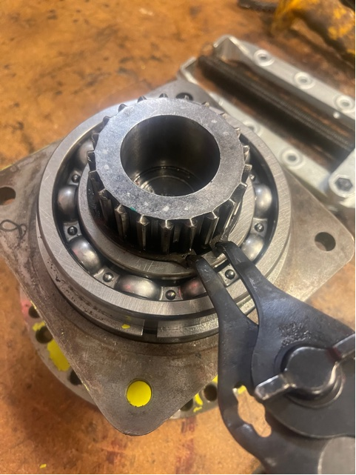
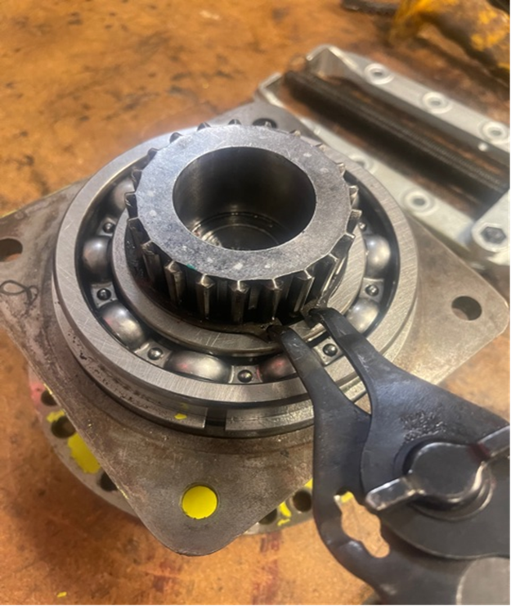
Part 1 – 537-1530-50-0 Tail Shaft Assembly Repair
G Series Tail Shaft Assembly Repair
Image of homemade brass insert tool
STEP 1. Using your snap ring pliers remove the snap ring from shaft groove (077-2750-01-0)

Slide 4
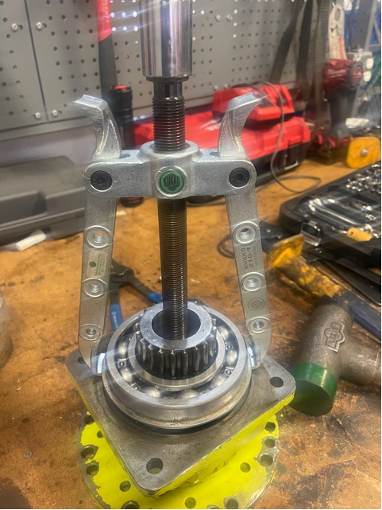
Part 1 – 537-1530-50-0 Tail Shaft Assembly Repair
G Series Tail Shaft Assembly Repair
STEP 2. Using a bearing puller apply the ears of the puller’s arms under the bearing (250-0214-06-0)
Note: Do not try to pull the housing cap as internal retaining rings will cause you to snap off at the housing flange

Slide 5
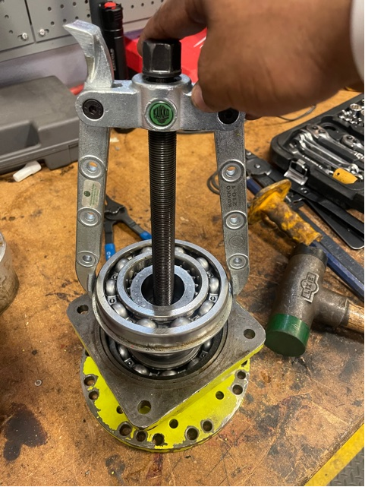
Part 1 – 537-1530-50-0 Tail Shaft Assembly Repair
G Series Tail Shaft Assembly Repair
STEP 3. Shows the (250-0214-06-0) bearing as the puller removes the bearing properly.

Slide 6
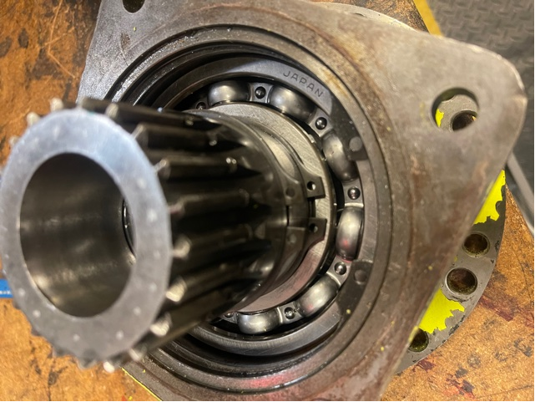
Part 1 – 537-1530-50-0 Tail Shaft Assembly Repair
G Series Tail Shaft Assembly Repair
Step 4. - Photo shows the 3 snap rings found on the shaft under the first bearing. 2 pcs. of 077-2750-01-0 on shaft and 077-5000-00-0 mounted into the outer housing.(250-0214-06-0)
Use appropriate snap ring pliers to remove each ring

Slide 7
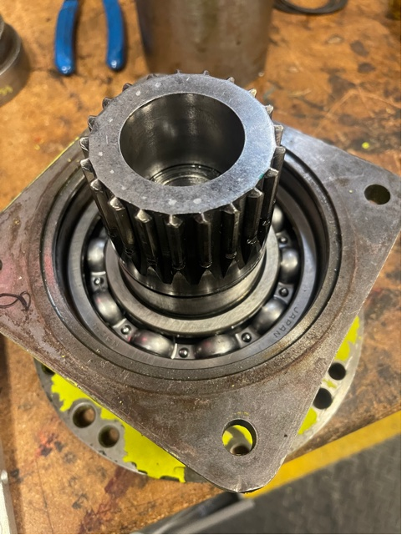
Part 1 – 537-1530-50-0 Tail Shaft Assembly Repair
G Series Tail Shaft Assembly Repair
This photo shows the assembly with the 3 snap rings removed.

Slide 8
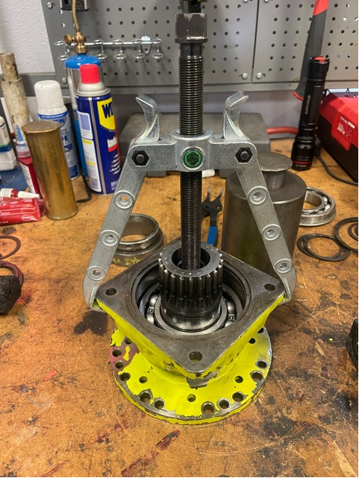
Part 1 – 537-1530-50-0 Tail Shaft Assembly Repair
G Series Tail Shaft Assembly Repair
STEP 5. Apply the bearing puller ears under the bearing cap now that the 3 snap rings have been removed to remove the (250-0214-00-0) and the bearing housing cap off the shaft.

Slide 9
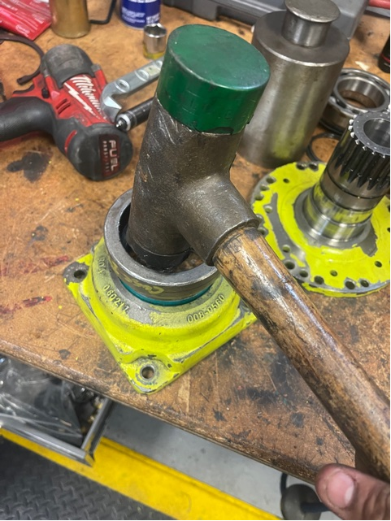
Part 1 – 537-1530-50-0 Tail Shaft Assembly Repair
G Series Tail Shaft Assembly Repair
STEP 6. Remove the old oil seal (296-2540-000-0) by hammering out of the bearing housing. A piece of 3” PVC pipe will work in place of a seal insert tool.

Slide 10
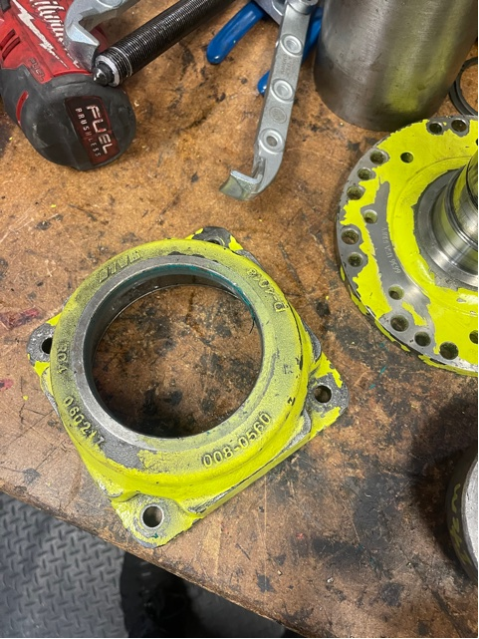
Part 1 – 537-1530-50-0 Tail Shaft Assembly Repair
G Series Tail Shaft Assembly Repair
STEP 7. Clean the bearing housing in order to remove all foreign materials that could affect seating of the oil seal.
Photo shows how housing looks before reassembly.

Slide 11
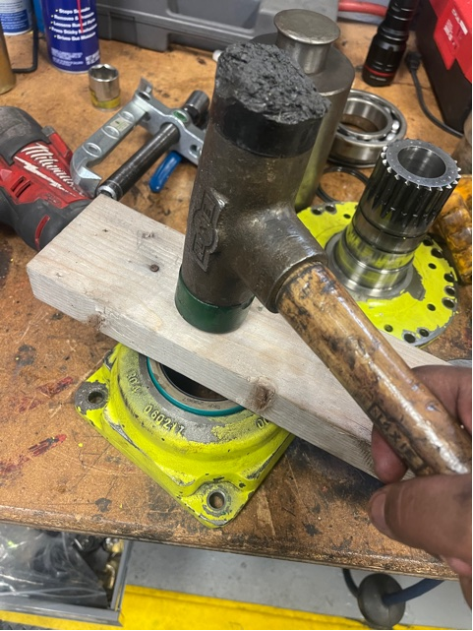
Part 1 – 537-1530-50-0 Tail Shaft Assembly Repair
G Series Tail Shaft Assembly Repair
STEP 8. Start by installing new oil seal (296-2540-00-0). Place seal on top of the bearing housing and tap down with seal tool or a flat piece of wood. Seal needs to be flush with the top of the bearing cap when properly installed.
Note: Use bearing grease on inside of the seal so that when sliding the housing over the shaft the surface will not be dry. If let dry you could damage the seal.

Slide 12
Part 1 – 537-1530-50-0 Tail Shaft Assembly Repair
G Series Tail Shaft Assembly Repair
STEP 9. Start by installing new oil seal (296-2540-00-0). Place seal on top of the bearing housing and tap down with seal tool or a flat piece of wood. Seal needs to be flush with the top of the bearing cap when properly installed.
Note: Use bearing grease on inside of the seal so that when sliding the housing over the shaft the surface will not be dry. If let dry you could damage the seal.

Slide 13
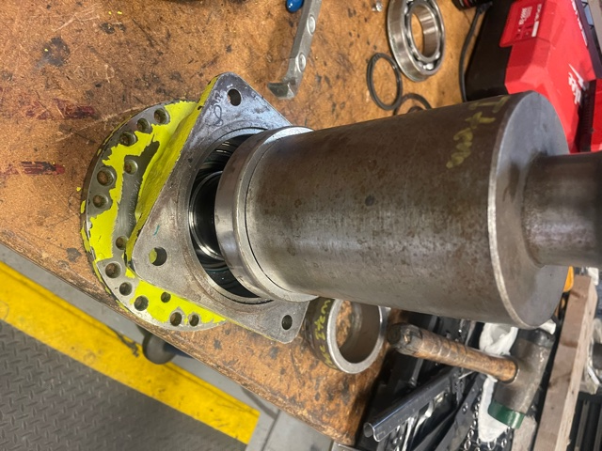
Part 1 – 537-1530-50-0 Tail Shaft Assembly Repair
G Series Tail Shaft Assembly Repair
STEP 10. Install the 214KG bearing (250-0214-00-0) either new or reuse the old bearing. Best to use a press for an even
Hale Recommends that this bearing always be replaced since a bearing pusher was used to remove, which could have caused damage to the bearing.
If reusing the old bearing make sure it spins freely, doesn’t bind or have damage to the rollers. If damaged replacement is required.

Slide 14
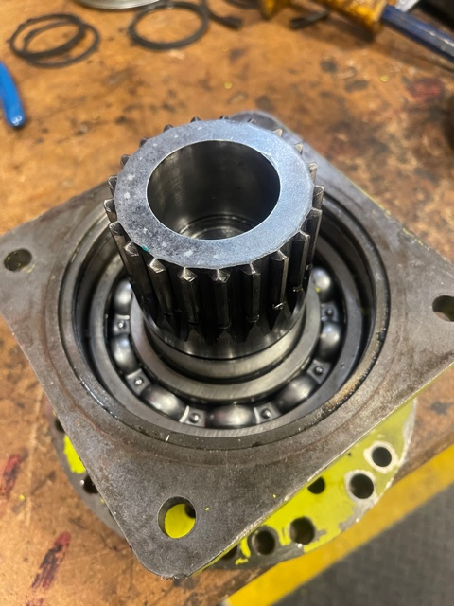
Part 1 – 537-1530-50-0 Tail Shaft Assembly Repair
G Series Tail Shaft Assembly Repair
Photo shows how the assembly should look after installation of the first bearing.

Slide 15
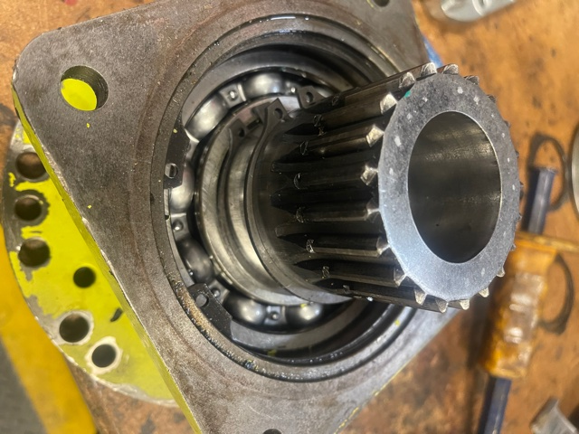
Part 1 – 537-1530-50-0 Tail Shaft Assembly Repair
G Series Tail Shaft Assembly Repair
STEP 11. Install all the three snap rings - 2 pcs. 077-2750-01-0 on shaft and 077-5000-00-0 in the bearing housing groove. You can reuse the old snap rings but make sure that they are not stretched or damaged. If damage is found purchase replacements.

Slide 16
Part 1 – 537-1530-50-0 Tail Shaft Assembly Repair
G Series Tail Shaft Assembly Repair
STEP 12. Install the 214KG bearing (250-0214-06-0) either new or reuse the old bearing removed from step 3. If reusing the old bearing make sure it spins freely, doesn’t bind or have damage to the rollers. If damaged replace with new.
Note: Use bearing pusher or tool or 3” PVC with a clean straight edge that sits evenly on the bearing fits over the shaft. Ensure the inside diameter of tool is larger than the shaft splines so as not to damage the teeth of shaft.
Suggestion: Using a bearing pusher that contacts both the inner and outer races on the bearing will provide the best results.

Slide 17
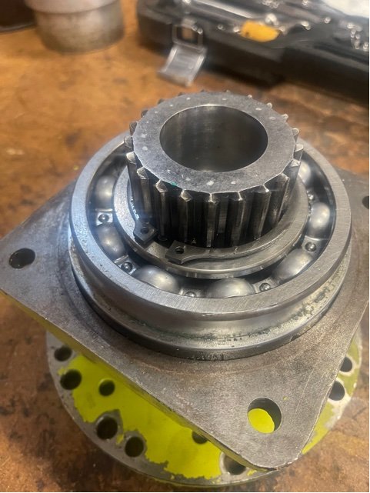
Part 1 – 537-1530-50-0 Tail Shaft Assembly Repair
G Series Tail Shaft Assembly Repair
STEP 13. Install the last snap ring (077-2750-01-0) into the shaft groove to hold bearing in place. If reusing the old ring make sure that it is not stretched or damaged. If damage is found purchase replacements.
Shaft assembly is now ready to be installed back into the gearbox. Please make sure to follow Hale’s shimming instructions to insure proper fit.

Slide 18
G Series Drive Shaft Diagnostics
G Series Drive Shaft Repair Supplies
Repair Kit Options
296-2540-00-0 Oil Seal Only – You will need gaskets and shim kit
546-0870-20-0 Input/Output Seal Repair Kit – Contains seals, shim kit and gaskets
546-0870-10-0 G Series Bearing and seal Kit – Use to replace all bearing and seals in a G Series gearbox.
Tool Options
Bearing puller
Socket wrench

Slide 19
607 NW 27th Avenue
Ocala, FL 34475
Phone (352) 629-5020
www.HaleTechnicalService.com

